Slide 1
Ch. 3 - Matter
States of Matter
Kinetic Molecular Theory
States of Matter

Slide 2
Lesson Objectives
I can describe the 4 states of matter in terms of KMT (the energy of the particles and the force of attraction between those particles.
I can diagram the way particles will look inside a solid, liquid, and gas.

Slide 3
Kinetic Molecular Theory
KMT
Particles of matter are always in motion.
The kinetic energy (speed) of these particles increases as temperature increases.

Slide 4
4 States of Matter
Solids
Liquids
Gases
Plasma

Slide 5
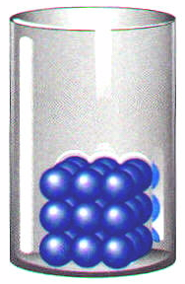
Four States of Matter: Solids
Solids
very low KE
particles vibrate but can’t move around
Definite shape
Definite volume
Can’ t be compressed

Slide 6
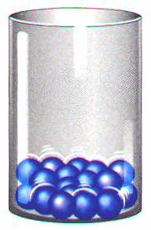
Four States of Matter: Liquids
Liquids
Medium KE
particles slide around but are still close together
Indefinite Shape
Definite Volume
Can’t be Compressed

Slide 7
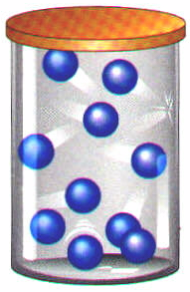
Four States of Matter: Gases
Gases
high KE - particles can separate and bounce throughout container
Indefinite shape
Indefinite volume
Can be Compressed

Slide 8
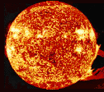
Four States of Matter: Plasma
Plasma
very high KE - particles collide with enough energy to break into charged particles (+/-)
gas-like, indefinite shape & volume
Magnetic fields affect them
stars, fluorescent light bulbs, CRTs

Slide 9
Chart of 4 States of Matter
State of Matter | Solid | Liquid | Gas | Plasma
Shape | Definite | Indefinite | Indefinite | Indefinite
Volume | Definite | Definite | Indefinite | Indefinite
Movement | Vibrate | Slide | Bounce | Bounce
Compressed? | No | No | Yes | Yes
Energy | Low | Middle | High | Very High
Particle Spacing | Tight | Loose | Spread out | Spread out
Attraction | Strong | Medium particles close but move | Hardly any | Hardly any

Slide 10
Big Ideas
The state of matter is determined by how fast the particles are moving and the attraction between them.
Kinetic Molecular Theory – All substances are in constant motion and the amount of motion is proportional to the temperature.

